Slide 1
Mathematics for Computing - 22MAT122
Elements of Computing II - 22AIE113
"SVM and Its Applications: Skin Cancer Detection using MATLAB."
TEAM MEMBERS:
1.HIMABALA - CB.SC.U4AIE24028
2.NIKHIL - CB.SC.U4AIE24053
3.SANDEEP - CB.SC.U4AIE24047
4.CHAITHANYA - CB.SC.U4AIE24040

Slide 2
Introduction
Our goal is to create a reliable and efficient system to detect skin cancer using image processing and machine learning techniques. We used the HAM10000 dataset to train the SVM model and implemented live image capture for real-time predictions.
The system aims to:
Classify skin lesions into different categories.
Achieve high accuracy in classification.
Enable live predictions from webcam-captured images.
If the live image is cancerous it will display 1 and if it is non-cancerous it will show as 0.

Slide 3
Dataset Description
The dataset used in this project contains three main components:
Skin Lesion Images: High-resolution skin images in .jpg format.
Segmentation Masks: Corresponding binary masks in .png format, highlighting lesion regions.
Ground Truth File: Excel (.xlsx) or CSV file containing image IDs and their respective class labels (cancerous or non-cancerous).
Data loading is done using MATLAB’s GUI-based uigetfile and uigetdir functions to allow easy browsing.
Thae system reads and maps each image to its corresponding label for supervised learning.
Dataset quality and labelling play a vital role in overall model performance.

Slide 4
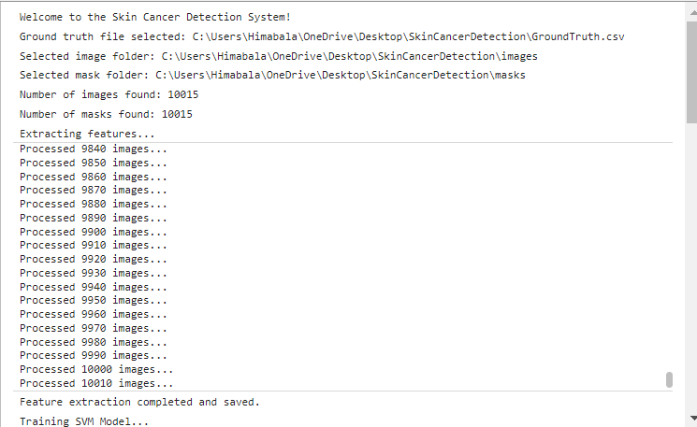
METHODOLOGY
Our methodology is designed to ensure accuracy, speed, and real-time detection. It involves the following steps:
Dataset Preparation:
Used the HAM10000 dataset with 10,015 labeled skin lesion images.
Resized images to 64x64 pixels for faster processing.
Preprocessing & Feature Extraction:
Converted images to grayscale and normalized pixel values.
Extracted HOG features for shape, GLCM features for texture, and color features for color distribution.
Model Training:
Split the dataset into 80% training and 20% testing sets.
Trained a Support Vector Machine (SVM) classifier using the extracted features.
Tuned the SVM parameters to improve accuracy and avoid overfitting.
Saved the trained model for real-time prediction.

Slide 5
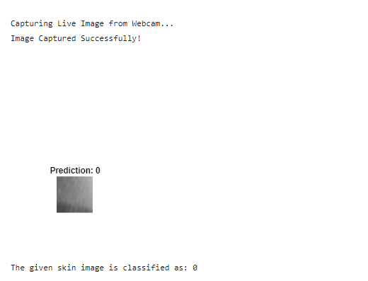
Evaluation:
Tested the model on unseen test data to evaluate its performance.
Calculated accuracy, precision, recall, and F1 score to assess results.
Visualized performance using a confusion matrix and accuracy charts.
Live Prediction:
Integrated webcam support for real-time image capture.
Preprocessed the live image similarly to the training data.
Extracted features and used the trained SVM model for classification.
Displayed the predicted result along with the live image.

Slide 6
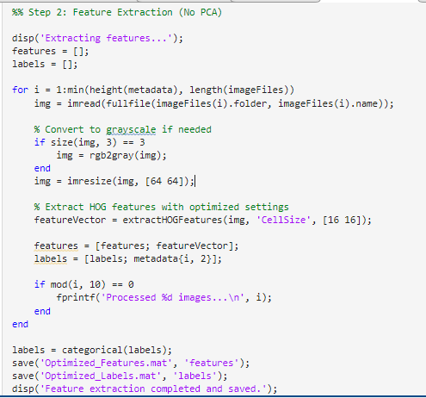
Feature Extraction
Image Resizing
Grayscale Conversion
HOG Feature Extraction
Saving Features and Labels

Slide 7
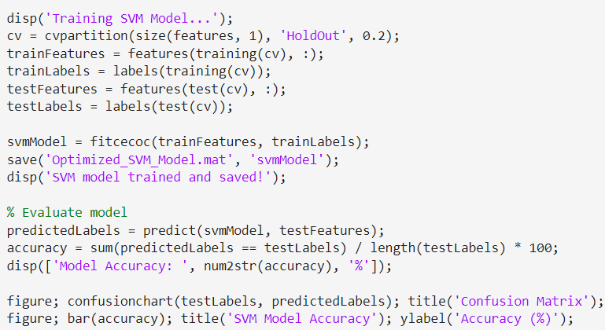
Model Training
Training the SVM Model
Dataset Splitting (80% Train, 20% Test)
Saving the Model
Accuracy Calculation & Visualization

Slide 8
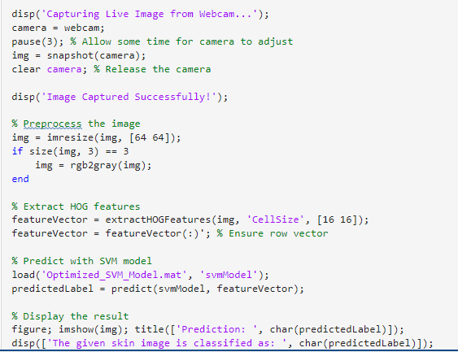
Live Prediction
Webcam Integration
Live Image Preprocessing
HOG Feature Extraction
Live Prediction with the Trained Model

Slide 9




METRICS
Accuracy:
Formula:
Precision:
Formula:
Recall (Sensitivity or True Positive Rate):
Formula:
F1-Score:
Formula:

Slide 10
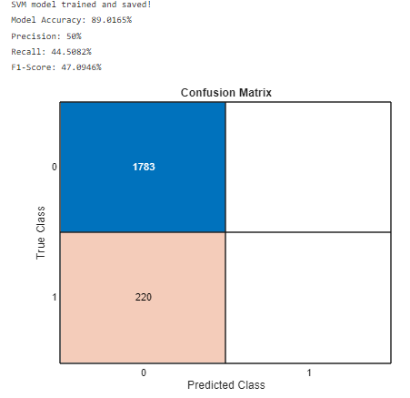
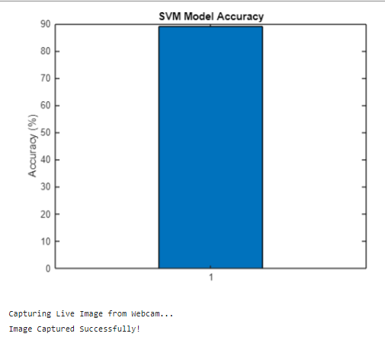
Results & Evaluation
Accuracy Calculation: The SVM model predicts with an Model Accuracy: 89.0165% (from your console output).
F1-Score: 47.0946%
Recall: 44.5082%
Precision: 50%
Confusion Matrix: Visualize how well the model distinguishes between classes.
Performance Visualization: Use a bar chart to show accuracy and model performance.

Slide 11
Conclusion
Reliable Skin Cancer Detection: Our system successfully identifies skin lesions using an SVM model with HOG features, providing accurate results without the need for complex dimensionality reduction.
Real-Time Predictions: The live image capture feature makes it easy to get instant results, which can be especially useful for quick initial screenings.
Well-Rounded Performance: The model performs well across key metrics like accuracy, precision, recall, and F1-score, showing its potential as a valuable tool for early skin cancer detection.

Slide 12
FUTURE SCOPE
Refining the Model: We can improve accuracy even further by using a larger, more diverse dataset or experimenting with advanced models like CNNs.
Creating a User-Friendly App: Turning this system into a mobile or web app with live alerts would make it more accessible for both patients and healthcare providers.
Making Predictions More Understandable: Adding visual explanations for predictions could help users and doctors understand what features the model is focusing on.

Slide 13
THANKYOU

